Slide 1
Construction Industry Scheme

Slide 2
Overview
Build a PwC advisory/compliance tool.
  The system will ingest contractor and subcontractor invoices and automatically classifies spend as "construction operations" vs "services" under the UK Construction Industry Scheme (CIS), an HMRC tax-deduction scheme.

Slide 3
Motivation
Who?
  Asset management firms diversifying into property/construction may not realise CIS applies to them until it becomes a compliance problem.
Value?
  More than a purely internal invoice-processing tool.
  PwC can offer/sell this system to clients
What?
  An automated way to:
    Flag CIS exposure, classify spend, and produce an audit-ready reasoning trail
Why?
  Reduces the risk of clients missing deductions or falling foul of HMRC without realising it.

Slide 4
Background: What is CIS
The Construction Industry Scheme is an HMRC scheme requiring contractors to deduct tax from payments made to subcontractors for construction operations.
Critical classification:
  Construction Operations
  Professional Services
  Off-site Manufacturing
  etc

Slide 5
Core Workflow
Invoices are dropped into front-end folder
User clicks process button to trigger pipeline
System reads invoices via OCR to extract text and line items from documents
Extracted data is parsed into structured fields
  E.g: supplier, amount, data, etc…*
Each line item is passed to LLM and:
  Classified
  Given a classification explanation
Classified data and reasoning trail are stored in a database
Raw invoice files stored in Azure Blob Storage
Results surfaced via API to the front end

Slide 6
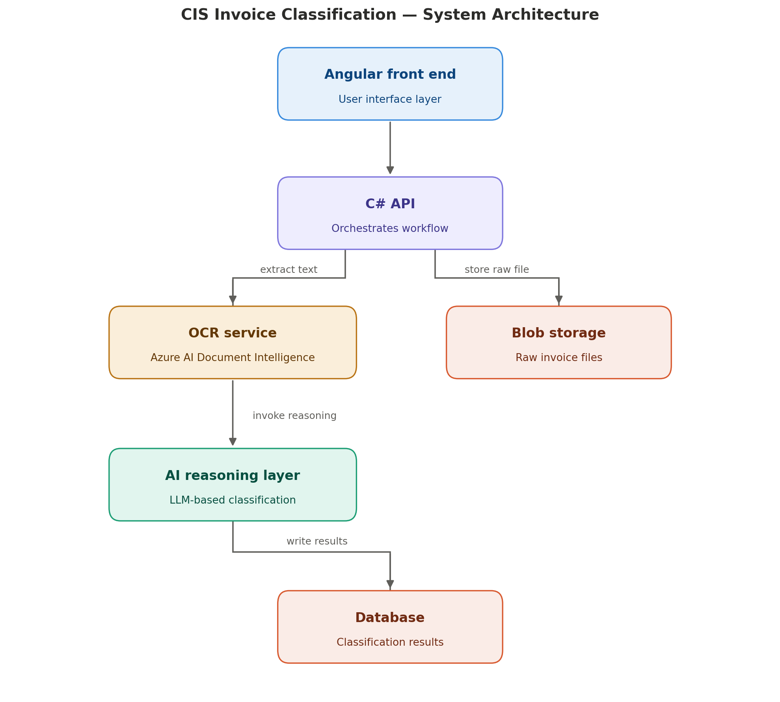
System Architecture Diagram

Slide 7
Tech Stack (as it stands)
Backend / API – C#
AI / Reasoning Layer – Azure OpenAI
OCR – Azure Document Intelligence
Storage – Azure Blob Storage
Front End – Angular
Database – TBD*

Slide 8
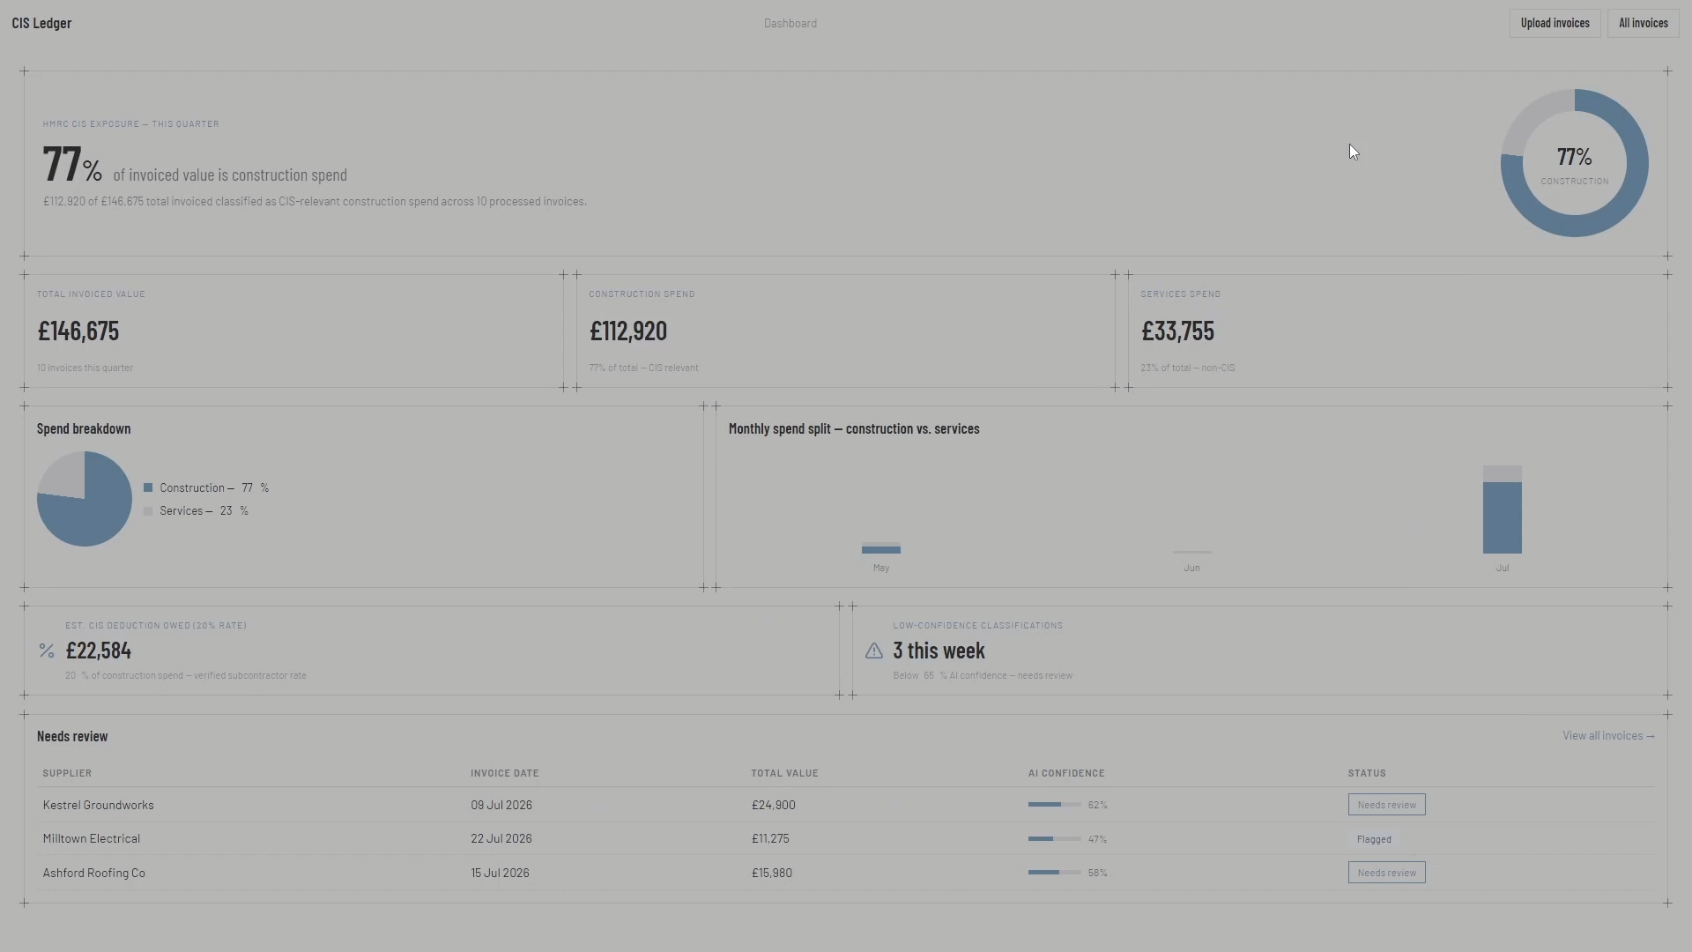
Prototype

Slide 9
Questions / Clarifications
What database technology does the firm standardise on (e.g. SQL Server, PostgreSQL, Cosmos DB)?
What level of audit trail / explainability is required for HMRC compliance purposes - does the reasoning text need to be stored permanently and retrievable?
Classification at line-item level vs invoice-level

